Slide 1
Introduction to Discrete Event Simulation Session 12
Arnold Buss
MOVES Institute
Naval Postgraduate School
Monterey, CA 93943

Slide 2

Overview
Simulation Output Analysis
Terminating and non-terminating simulations
Estimating a confidence interval for a terminating simulation
The meaning of what is estimated

Slide 3

Simulation Output Analysis
Objective: learn something about the system being modeled
Discrete Event Simulations are typically stochastic
Fancy word for “random”
One replication may not be representative of the system
Can you estimate Pr{heads} from one coin flip?

Slide 4

Simulation Output Analysis
What is the average waiting time for customers?
What is the average time to process a job?
What is the average percentage of lost customers due to reneging?

Slide 5

Output Analysis for One Measure
A single replication is not sufficient
If we want to estimate the mean, the sample average is a good place to start . . .
But it still doesn’t give information about how accurate that estimate is
Therefore, we need a confidence interval

Slide 6
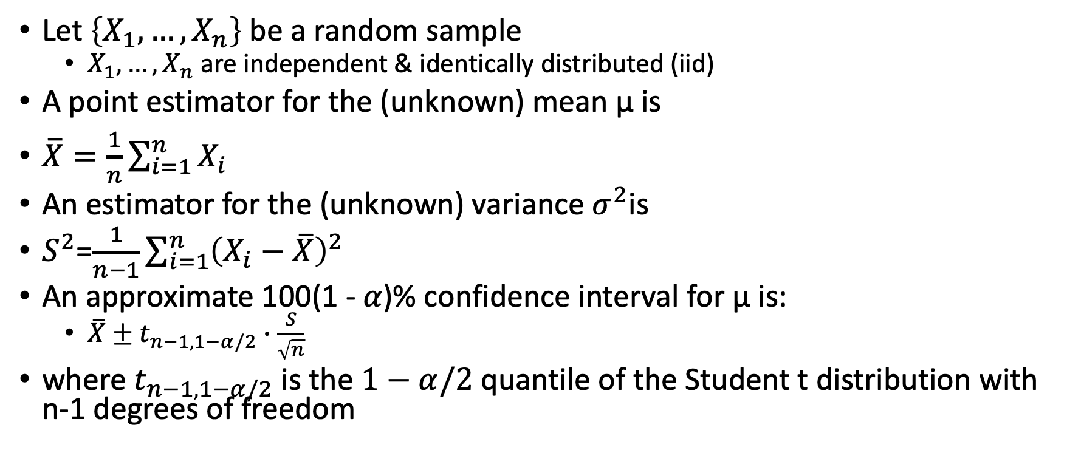
Recall from Statistics
Let $\left\{X_{1},…,X_{n}\right\}$ be a random sample
$X_{1},…,X_{n}$ are independent & identically distributed (iid)
A point estimator for the (unknown) mean μ is
$\overline{X}=\frac{1}{n}\sum_{i=1}^{n}{X_{i}}$
An estimator for the (unknown) variance $σ^{2}$is
$S^{2}$=$\frac{1}{n−1}\sum_{i=1}^{n}{{\left(X_{i}−\overline{X}\right)}^{2}}$
An approximate 100(1 - 𝛼)% confidence interval for μ is:
$\overline{X}±t_{n−1,1−α/2}∙\frac{S}{\sqrt{n}}$
where $t_{n−1,1−α/2}$ is the $1−α/2$ quantile of the Student t distribution with n-1 degrees of freedom

Slide 7
Terminating & Non-Terminating Simulations
Terminating Simulation
“Natural” end event or condition
Examples:
“Winning” a combat scenario
Facility opens in morning and closes in afternoon
Non-terminating Simulation
No “natural” end condition
May run indefinitely
Either reaches steady-state or “blows up”

Slide 8
Estimating Measure for Terminating Simulation
What is being estimated?
individual observations are not iid
Typically some function of individual observations
Examples
Average delay in queue over the day
Maximum number in queue over the day
Average number in queue over the day

Slide 9
Difficulty Applying “Normal” Statistics
Raw simulation data is typically not iid (independent & identically distributed).
Example: Successive delays in queue:
D₁, D₂, …, D_{n}
Not identically distributed – each has a different mean
Not independent – knowing D_{i} gives information about D_{i+1}

Slide 10
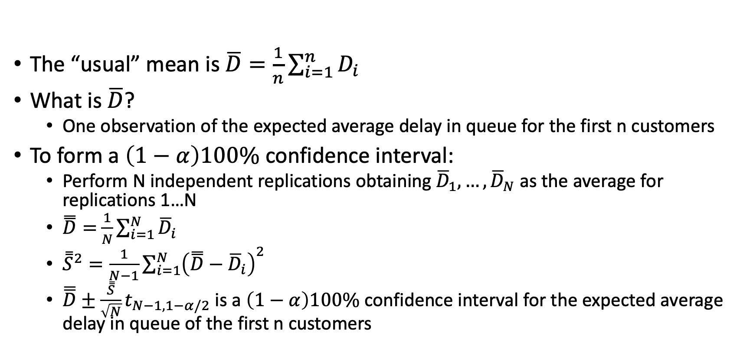
Estimation
The “usual” mean is $\overline{D}=\frac{1}{n}\sum_{i=1}^{n}{D_{i}}$
What is $\overline{D}$?
One observation of the expected average delay in queue for the first n customers
To form a $\left(1−α\right)100\%$ confidence interval:
Perform N independent replications obtaining ${\overline{D}}_{1},…,{\overline{D}}_{N}$ as the average for replications 1…N
$\overset{̿}{D}=$ $\frac{1}{N}\sum_{i=1}^{N}{{\overline{D}}_{i}}$
${\overset{̿}{S}}^{2}=\frac{1}{N−1}\sum_{i=1}^{N}{{\left(\overset{̿}{D}−{\overline{D}}_{i}\right)}^{2}}$
$\overline{\overline{D}}±\frac{\overset{̿}{S}}{\sqrt{N}}t_{N−1,1−α/2}$ is a $\left(1−α\right)100\%$ confidence interval for the expected average delay in queue of the first n customers

Slide 11
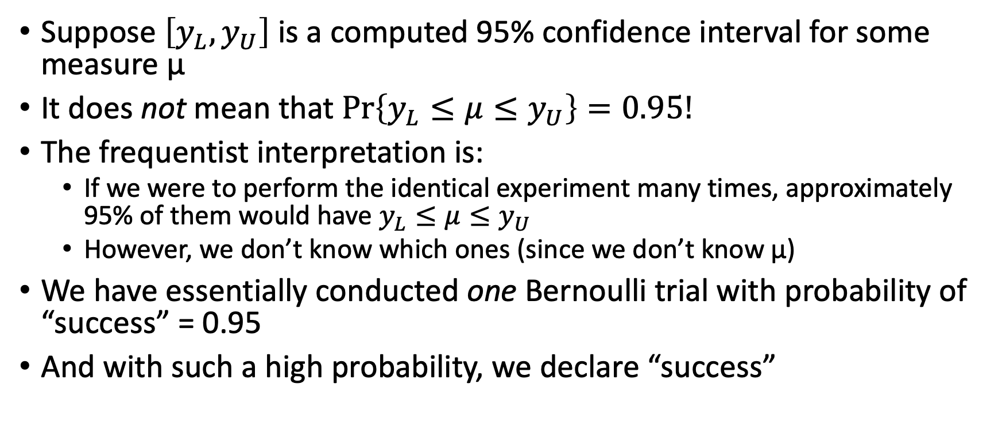
Meaning of Confidence Interval
Suppose $\left[y_{L},y_{U}\right]$ is a computed 95% confidence interval for some measure μ
It does not mean that $Pr\left\{y_{L}≤μ≤y_{U}\right\}=0.95!$
The frequentist interpretation is:
If we were to perform the identical experiment many times, approximately 95% of them would have $y_{L}≤μ≤y_{U}$
However, we don’t know which ones (since we don’t know μ)
We have essentially conducted one Bernoulli trial with probability of “success” = 0.95
And with such a high probability, we declare “success”

Slide 12
Implementation
Use one statistics object to collect data within a replication
The “inner” stat object
Use a second to collect data from the inner stat object
The “outer” stat object
After each replication. . .
Pass the value from the inner stat to the outer stat object
Reset the inner stat object
Result: independent, identically distributed (IID) observations

